Slide 1
EE 210
LECTURE 6
Inductance Capacitance Cenk Efeler
Reference Book :Electric Cırcuits
James W.Nielson & Susan A.Riedel

Slide 2
Inductance,Capacitance
Analysis techniques introduced in Chapters 3 and 4 apply to circuits containing inductors and capacitors.
Like other components inductors and capacitors are easier to describe in terms of circuit variables rather than electromagnetic field variables.
An inductor is an electrical component that opposes any change in electrical current.It consists of a coil and wire wound around a supporting core whose material may be magnetic or nonmagnetic.

Slide 3
Inductor
The behaviour of inductors is related to a phenomena associated with magnetic fields.The source of magnetic field is the charge in motion,or current.
A time-varying magnetic field induces a voltage in any conductor linked by the field.
The circuit parameter of inductance relates the induced voltage to the current.

Slide 4
Capacitor
A capacitor is an electrical component that consists of two conductors separated by an insulator or dielectric material.
The capacitor is the only device other than battery that can store electrical charge.
The behaviour of capacitors is based on a phenomena associated with electric fields.
The source of the electric field is the separation of charge,or voltage.
If the voltage varies with time,the electric field varies with time as well.

Slide 5
Capacitor
A time-varying electric field produces a displacement current in the space occupied by the fields.
The circuit parameter of capacitance relates the displacement current to the voltage,where the displacement current is equal to the conduction current at the terminals of the capacitor.

Slide 6
Inductance,Capacitance
Energy can be stored in both magnetic and electric fields,thus both inductors and capacitors are capable of storing energy.In ideal inductors and capacitors,only as much energy can be extracted as has been stored.
Because inductors and capacitors cannot generate energy,they are classified as passive elements.

Slide 7
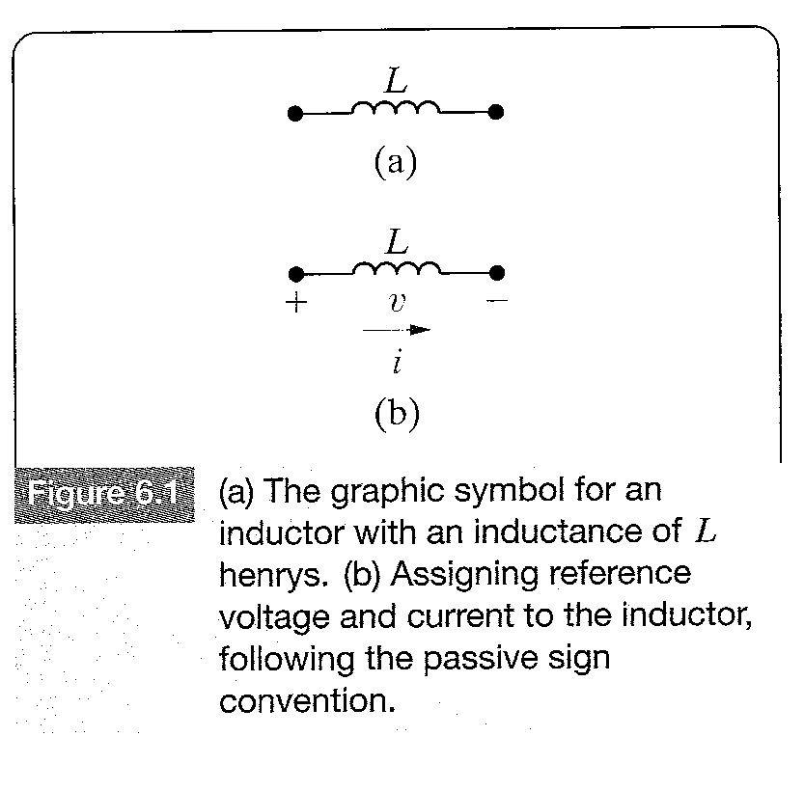
Inductor.
Inductance is the circuit parameter used to describe an inductor.Inductance is symbolized by the letter L,is measured in Henrys(H),and is represented graphically as a coiled wire - a reminder that inductance is a consequence of a conductor linking a magnetic field. Figure 6.1 shows an inductor.

Slide 8
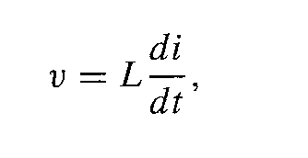
Inductor
Assigning the reference direction of the current in the direction of the voltage drop across the terminals of the inductor yields:
(6.1)
Where v is measured in volts,L in henrys,i amperese and t in seconds.

Slide 9
Inductor
Equation 6.1 reflects the passive sign convention shown in Figure 6.1 b).If the current reference is in the direction of the voltage rise,Equation 6.1 is written with a minus sign.
Two observations can be made from Equation 6.1.As the voltage across the terminals of an inductor is proportional to the time rate of change of the current in the inductor,if the current is constant,the voltage across the ideal inductor is zero.Thus the inductor behaves as a short circuit in the presence of a constant or d.c source.

Slide 10
Inductor
The second observation is that the current in an inductor cannot change instantaneously,that is the current cannot change by a finite amount,in zero time.Such a change in energy would require an infinite voltage,and infinite voltages are not possible.
For example,when someone opens the switch on an inductive circuit in an actual system,the current initially continues to flow in the air across the switch,a phenomenon called arching.The arc across the switch prevents the current from dropping zero instantaneously.

Slide 11
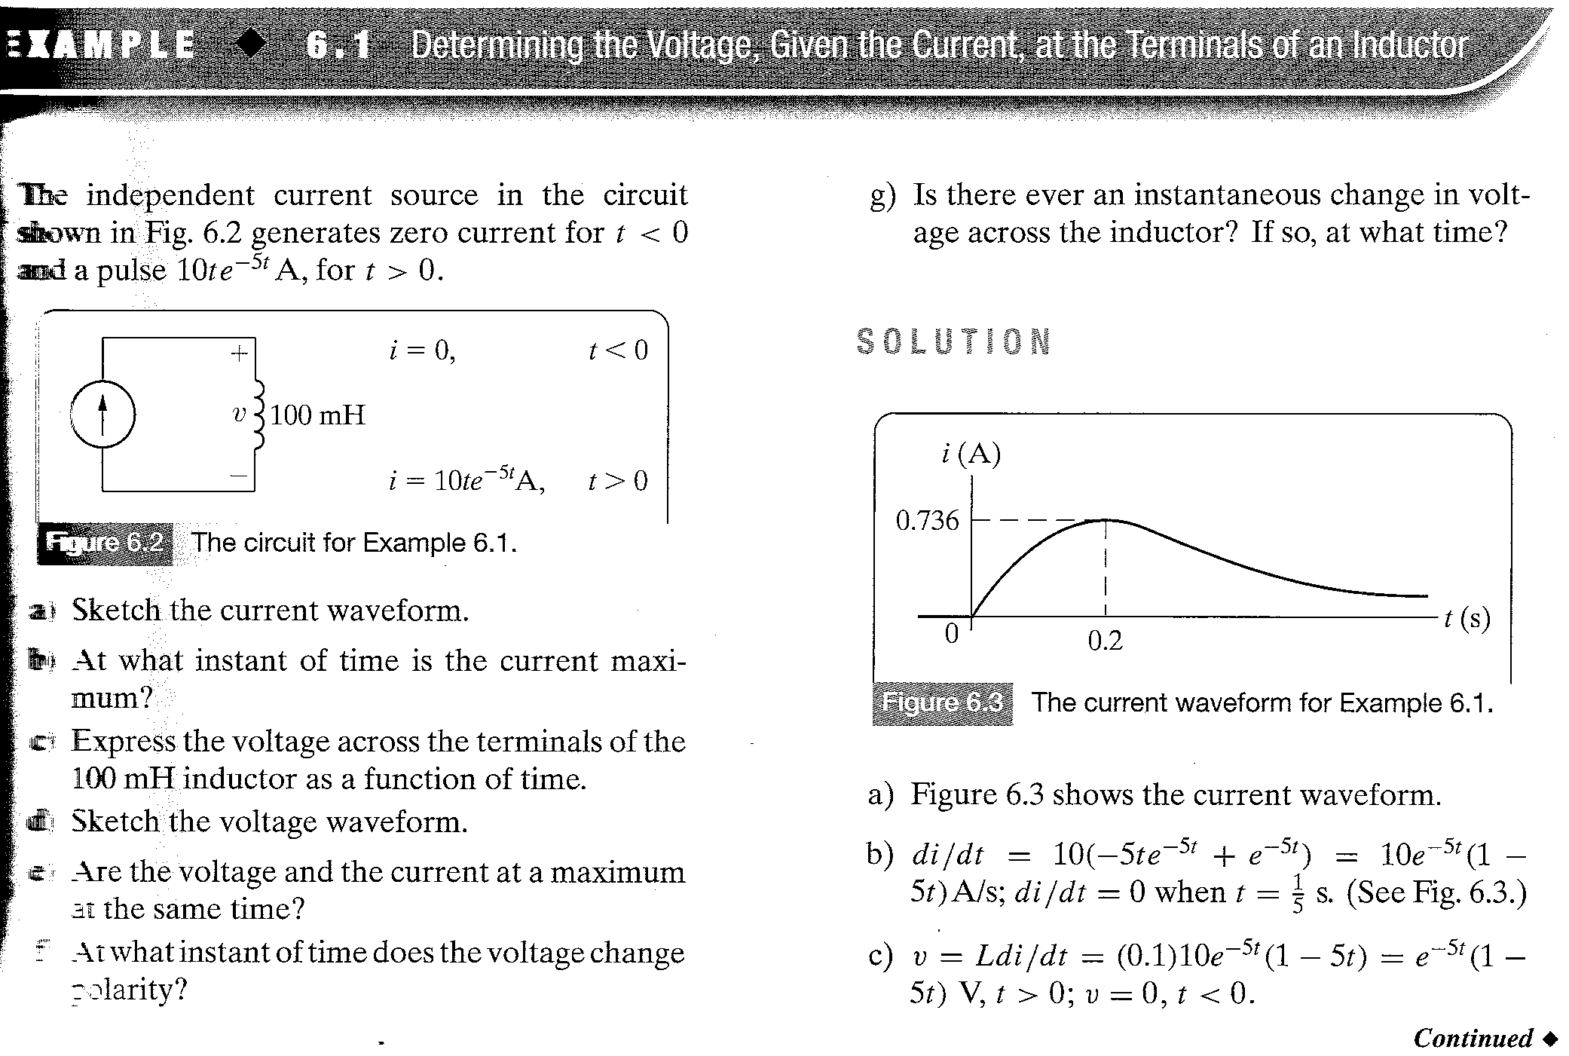
EXAMPLE 6.1

Slide 12
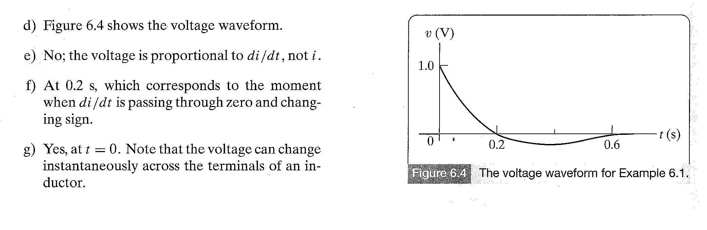
EXAMPLE 6.1

Slide 13
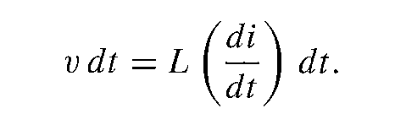
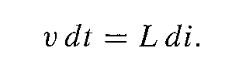
Current in an inductor in Terms of the Voltage Across the Inductor
To find the current i in the inductor as a function of the voltage v across the inductor, we first multiply both sides of equation 6.1 by a differential time dt.
(6.2)
Multiplying the rate at which i varies with t by a differential change in time generates a differential change in i,so we write Equation 6.2 as
(6.3)

Slide 14
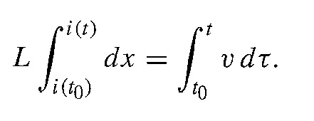
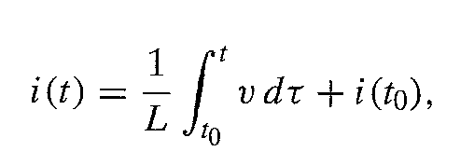
Current in an inductor in Terms of the Voltage Across the Inductor
Next,we interchange both sides and integrate
(6.4)
Where x and are used as the variables of integration and i and t become the limits on the integrals.Then from (6.4)
(6.5)
Where i(t) is the current corresponding to t,and i(t0) is the value of the inductor current when we initiate the integration namely t0.

Slide 15
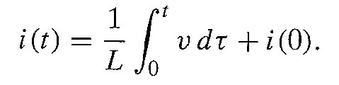
Current in an inductor in Terms of the Voltage Across the Inductor
In many practical applications,t0 is zero and Equation 6.5 becomes
(6.6)
In both equation 6.1 and 6.5 the reference direction for the current is in the direction of the voltage drop across the terminals.Note that i(t0) carries its own algebraic sign.If the initial current is in the opposite direction,it is a negative quantity.

Slide 16
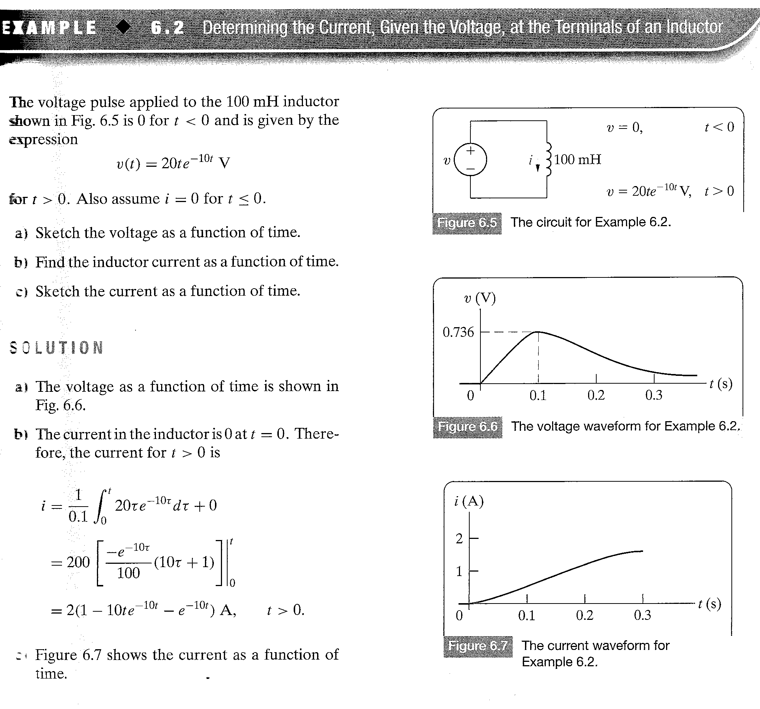
Example 6.2

Slide 17

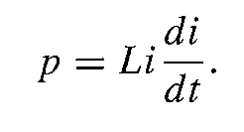
Power and Energy in the Inductor
The power and energy relationships for an inductor can be derived directly from the current and voltage relationships.If the current reference is in the direction of the voltage drop across the terminals of the inductor,the power is
(6.7)
The power is in watts,voltage in volts,and current is in amperes.Expressing the inductor voltage as a function of the inductor current Equation 6.7 becomes
(6.8)

Slide 18
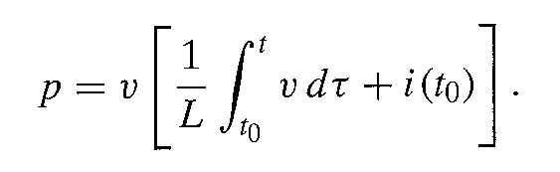
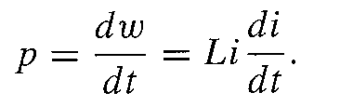
Power and Energy in the Inductor
We can also express the current in terms of the voltage:
(6.9)
Equation 6.8 is useful in expressing the energy stored in the inductor.Power is the time rate of expending energy,so
(6.10)

Slide 19

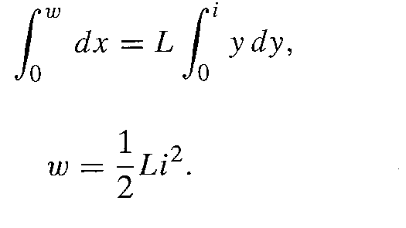
Power and Energy in the Inductor
(6.11)
(6.12)

Slide 20
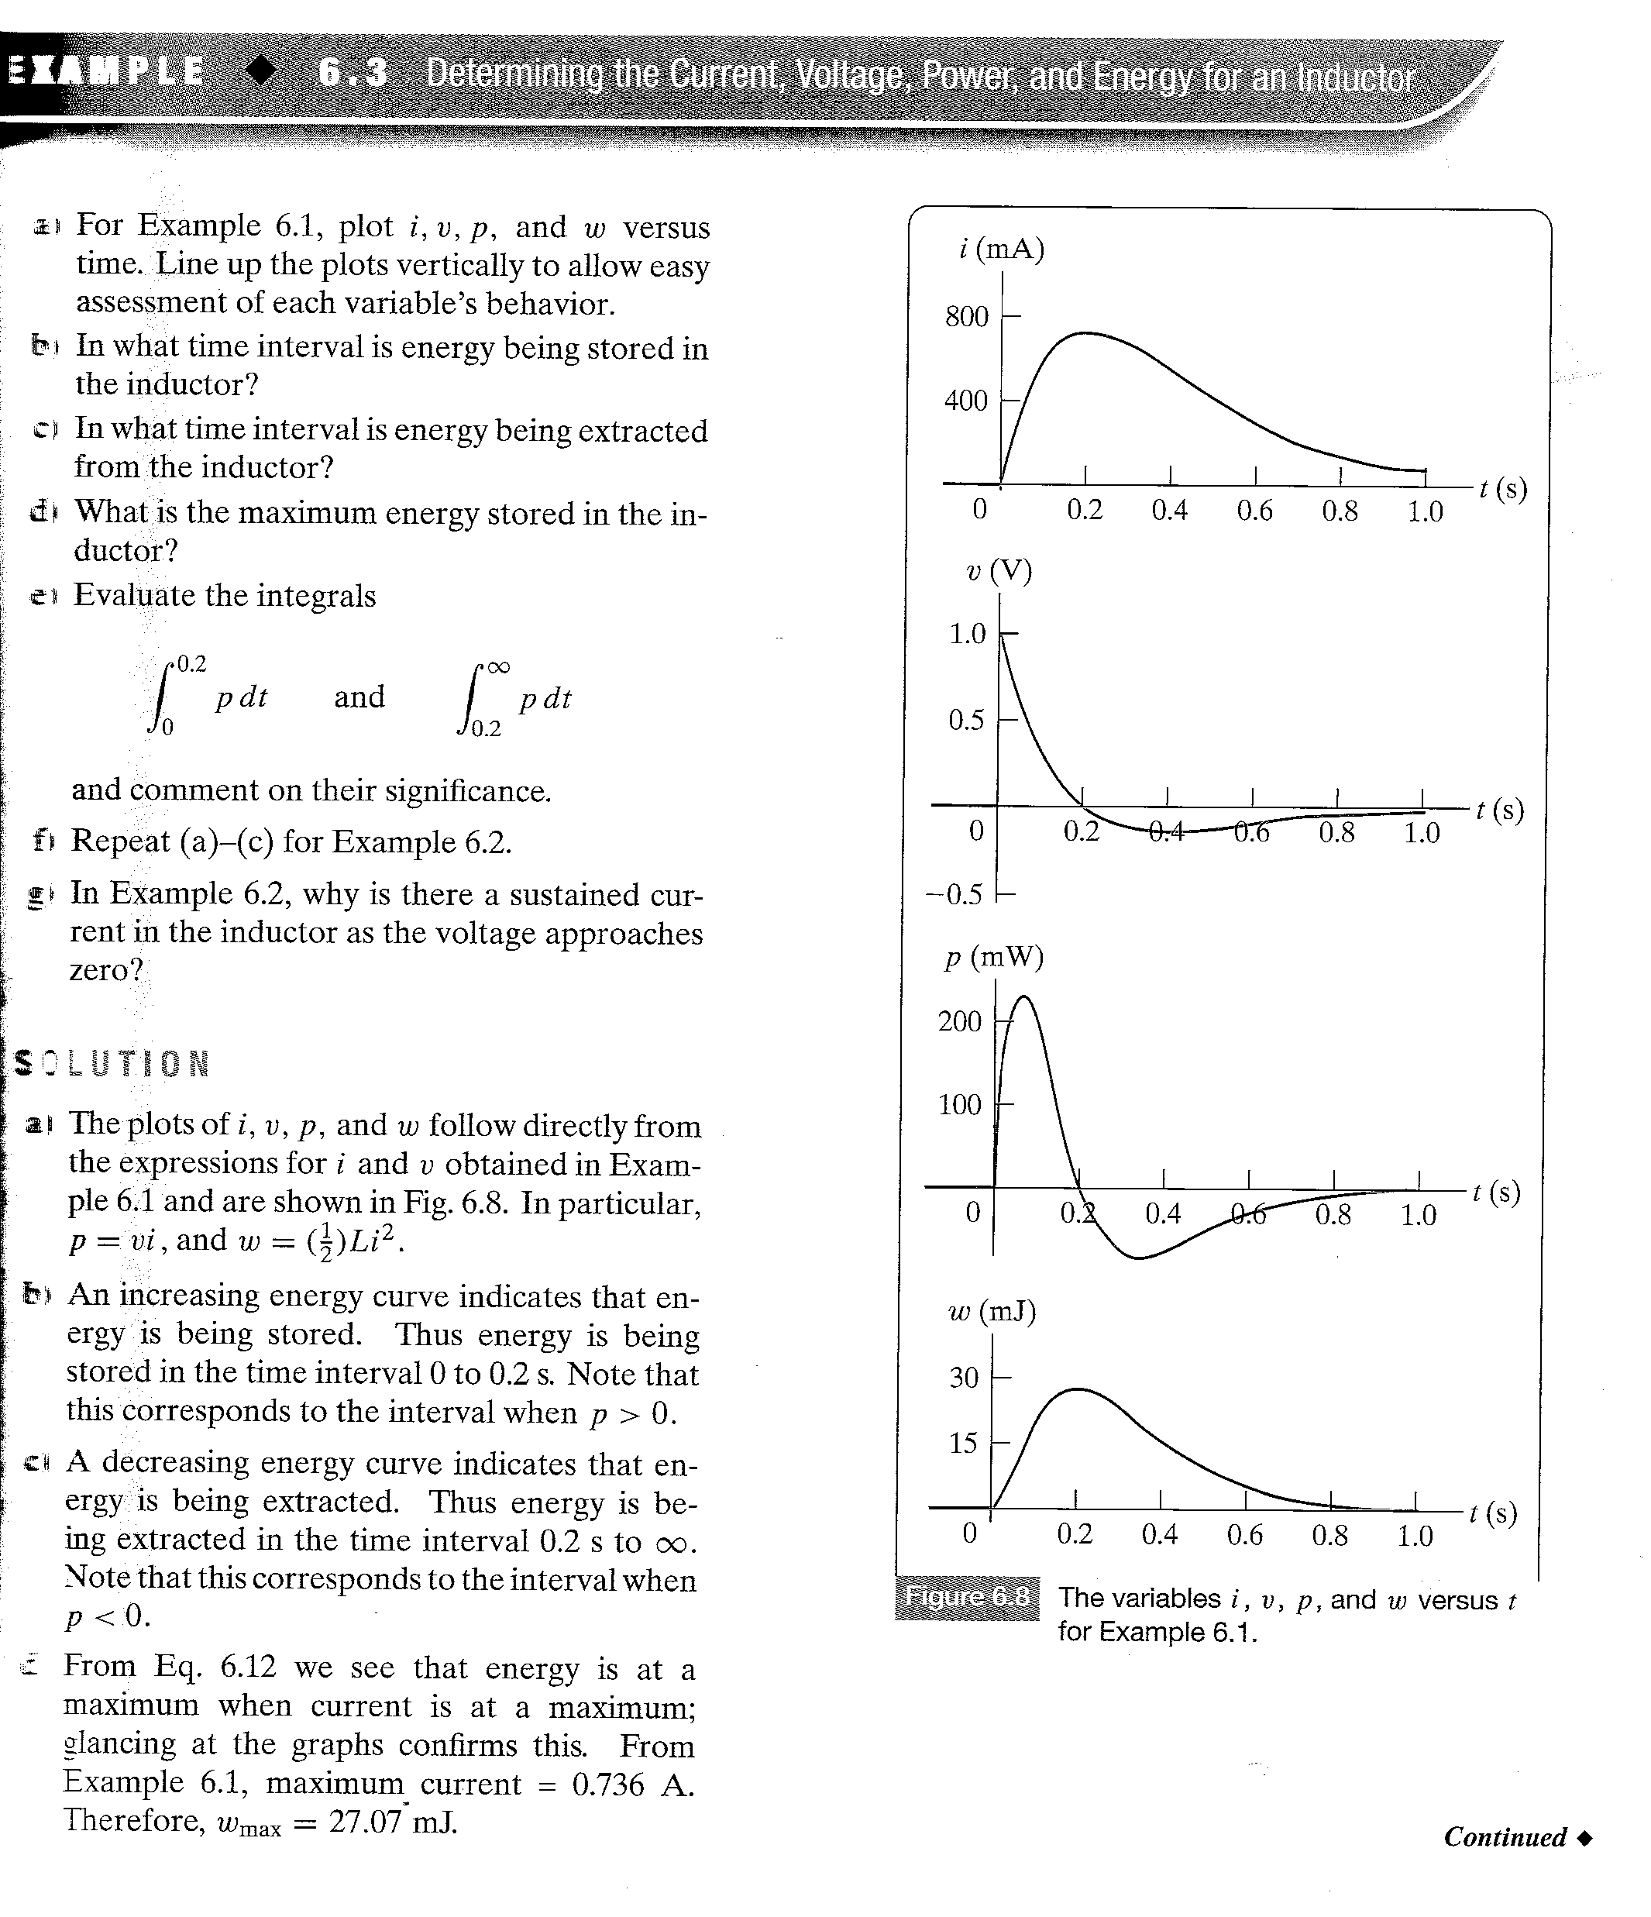
Example 6.3

Slide 21
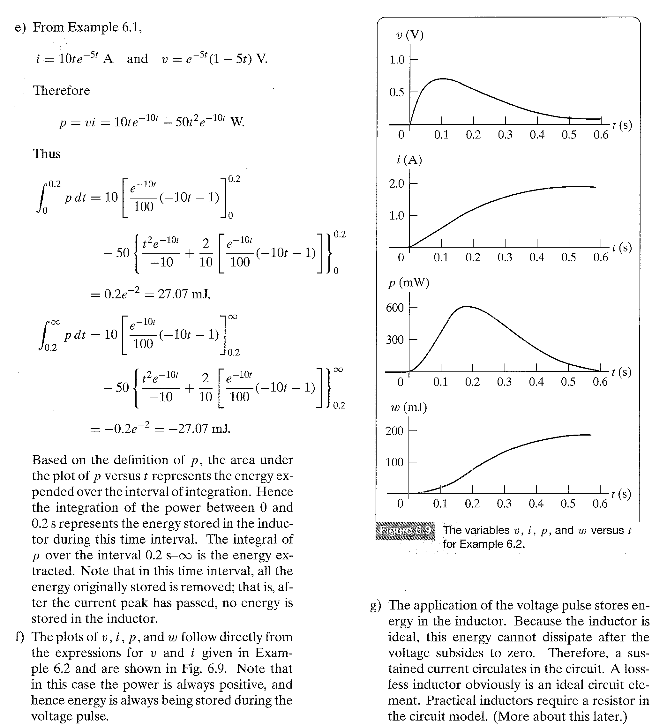
Example 6.3

Slide 22
Homework: Assesing Objective 1 => 6.1

Slide 23
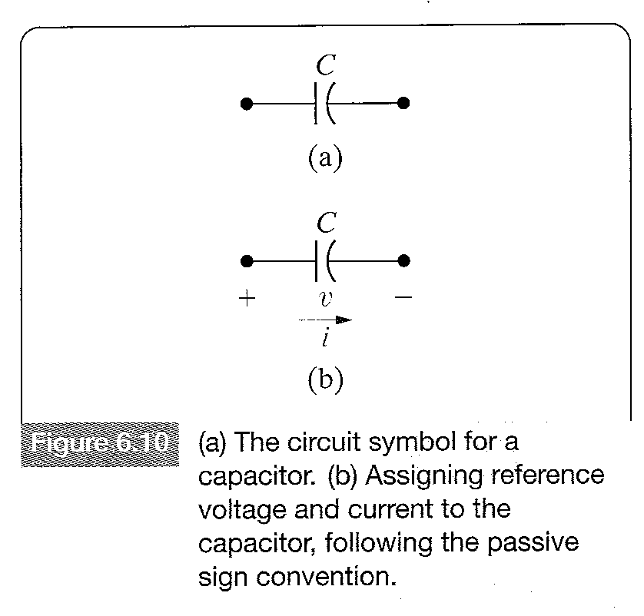
The Capacitor
The circuit parameter of capacitance is represented by the letter C,is measured in Farads (F),and is symbolized graphically by two short parallel conductive plates as shown in Figure 6.10(a).

Slide 24
The Capacitor
Because Farad is an extremely large quantity of capacitance practical capacitor values usually lie in the picofarad (pF) to microfarad ( F) range.
Capacitance occurs whenever electrical conductors are separated by a dielectric,or insulating material.This condition implies that electric charge is not transported through the capacitor.
Allthough appying a voltage to the terminals of the capacitor cannot move a charge through the dielectric,it can displace a charge within the dielectric.As the voltage changes with time,the displacement of charge also varies with time,causing what is known as the displacement current.

Slide 25
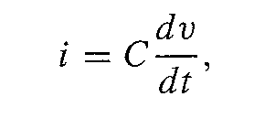
The Capacitor
At the terminals,the displacement current is indistinguishable from a conduction current.The current is proportional to the rate at which the voltage across the capacitor varies with time,or mathematically,
(6.13)
where i is measured in amperes,C in farads,v in volts and t in seconds.
Equation 6.13 reflects the passive sign convention shown in Figure 6.10 b).If the current reference direction is in the direction of the voltage rise,Equation 6.13 is written with a minus sign.

Slide 26
The Capacitor
Two important observations can be made from Equation 6.13.First,the voltage across a capacitor cannot change instantanously,as this change would produce infinite current,a physical impossibility.
Second,if the voltage across the terminals is constant,the capacitor current is zero.The reason is that a conduction current cannot be established in the dielectric material of the capacitor.Only a time-varying voltage can produce a displacement current.Thus a capacitor behaves as an open circuit in the presence of a constant voltage.

Slide 27
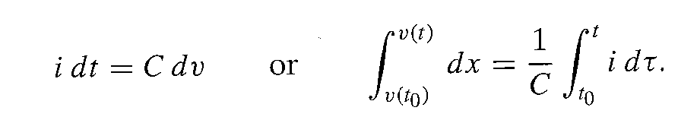
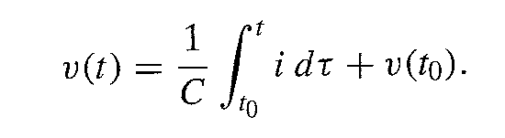
The Capacitor
Expressing the voltage across the capacitor is also useful.Multiplying both sides of equation 6.13 by a differential time dt and then inregrating the resulting differentials:
Carrying out the integration on the left-hand side of the second equation gives
(6.14)

Slide 28
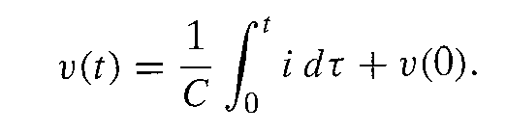
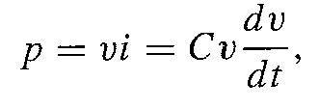
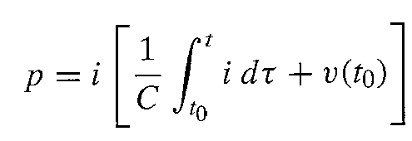
The Capacitor
In many practical applications of Equation 6.14,the initial time is zero;that is t0=0.Thus Equation 6.14 becomes:
(6.15)
From the definition of power
(6.16)
(6.17)

Slide 29

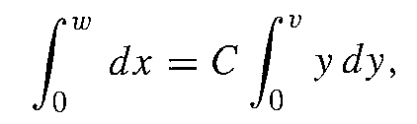
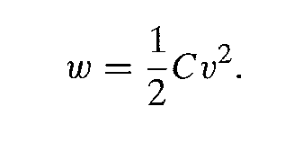
The Capacitor
Combining the definition of energy with Equation 6.16 yields
From which
(6.18)
In the derivation of Equation 6.18,the reference for zero energy corresponds to zero voltage.

Slide 30
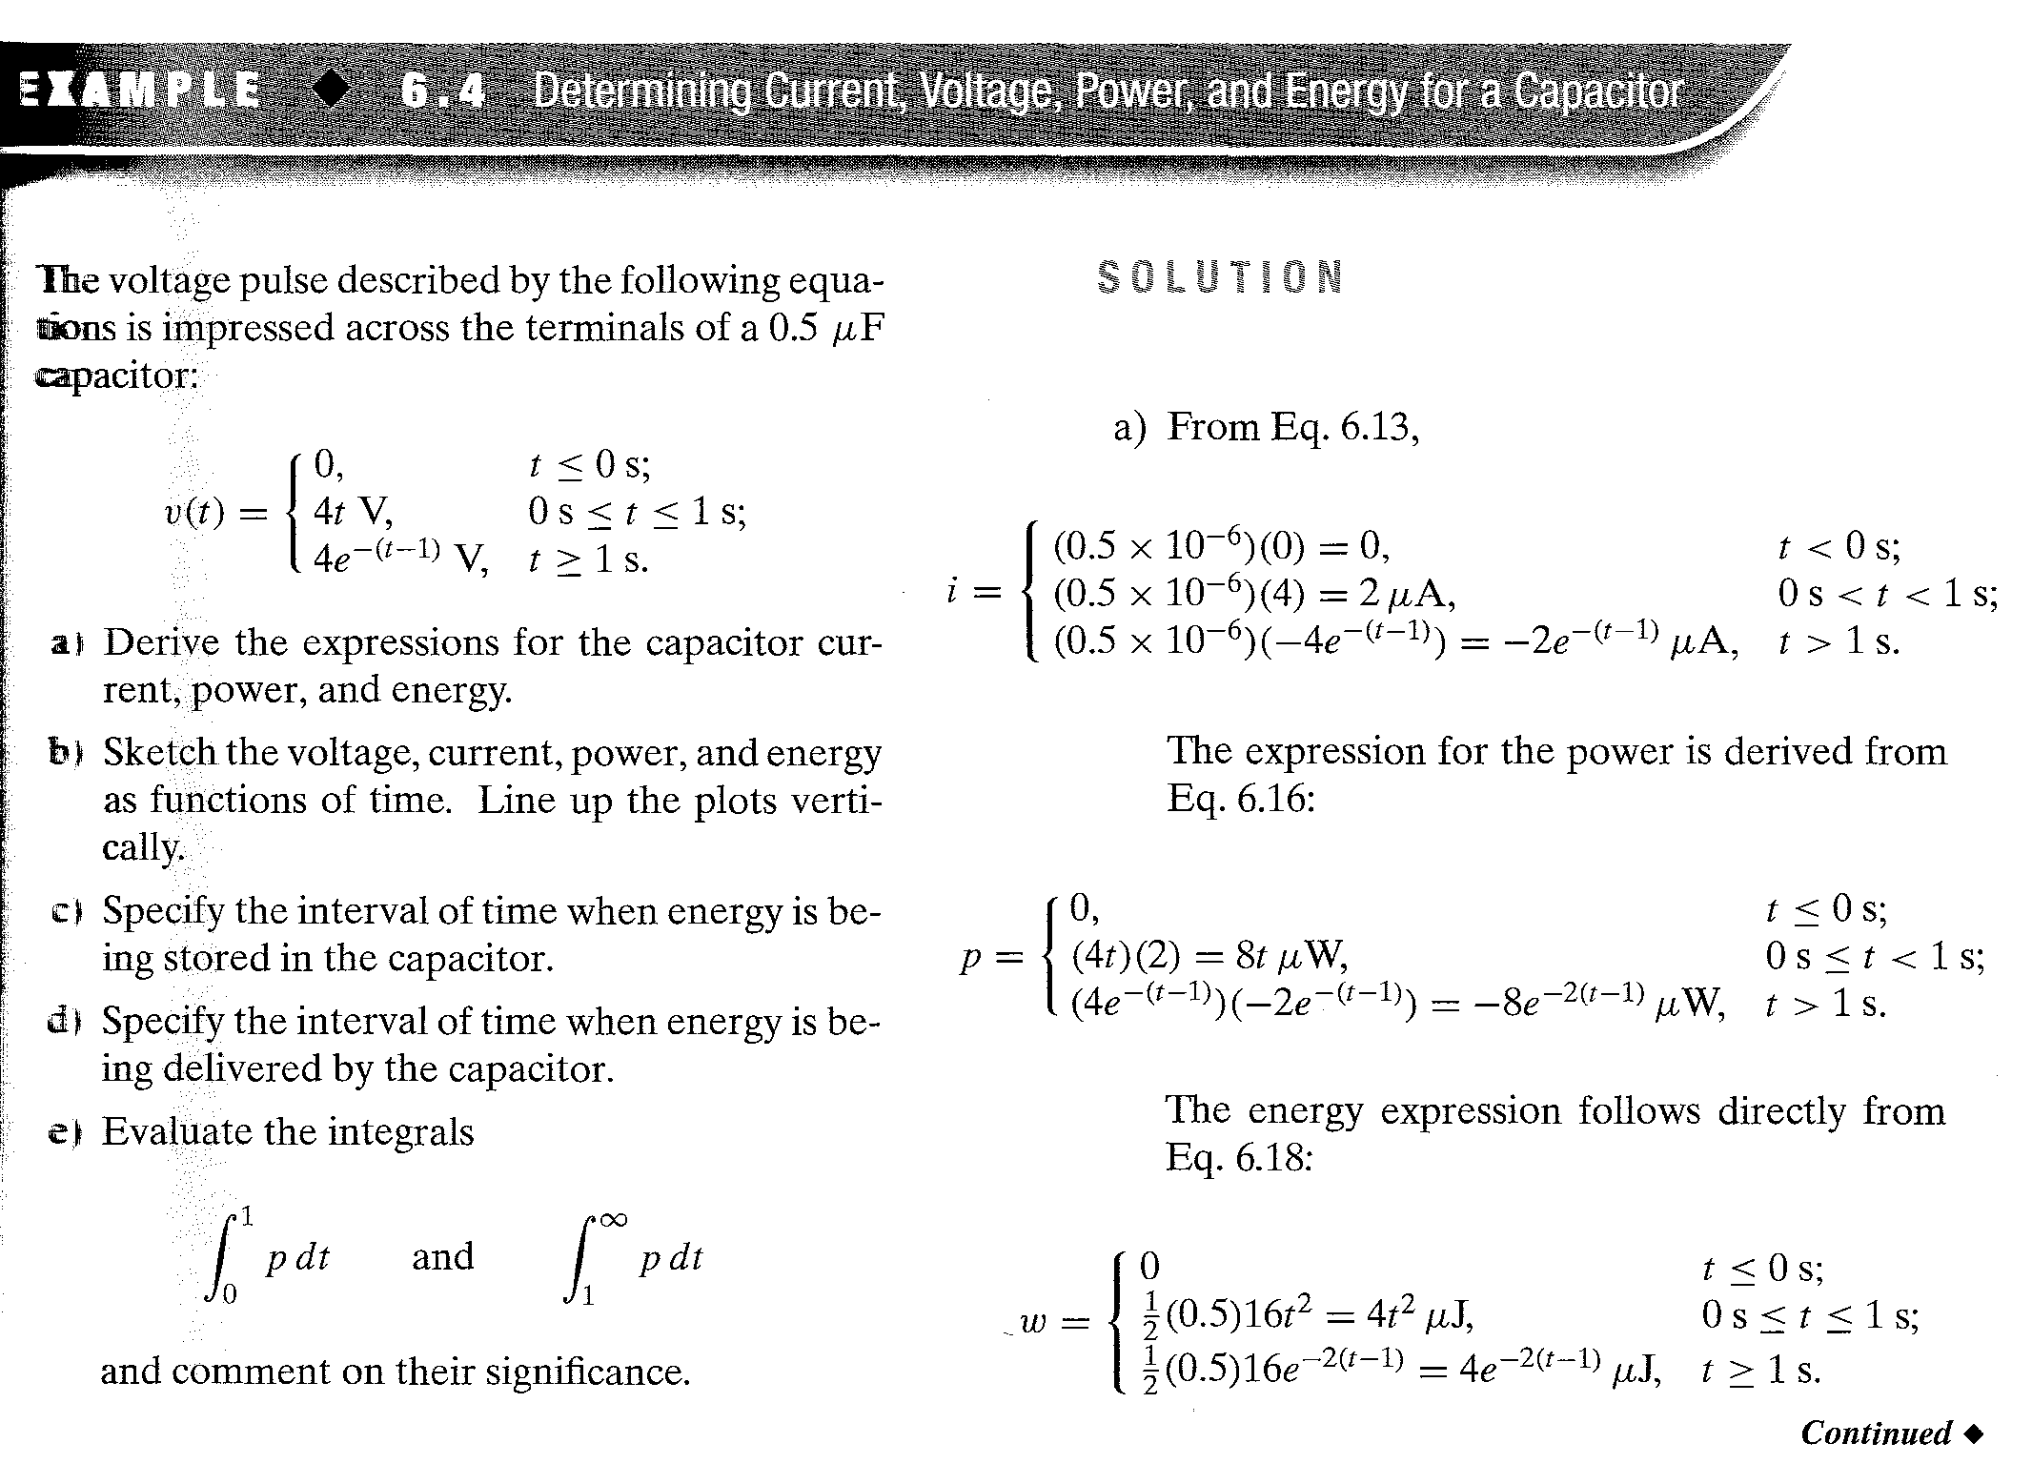
Example 6.4

Slide 31
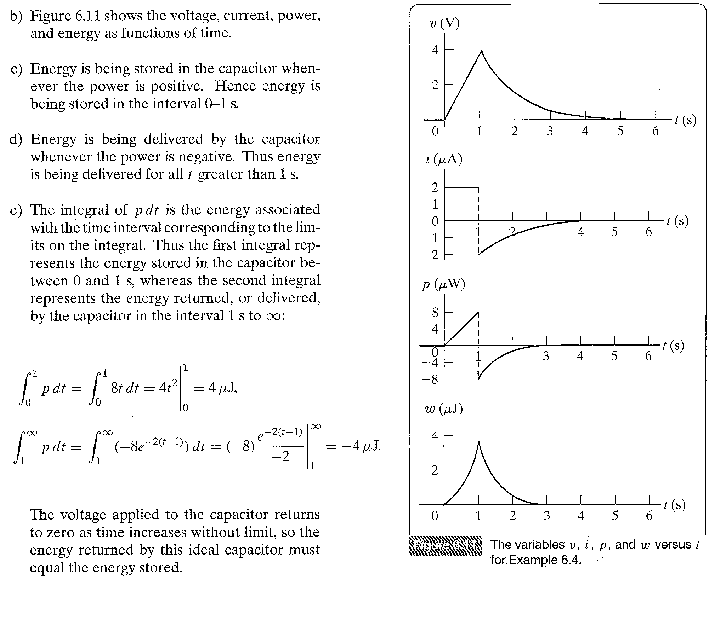
Example 6.4

Slide 32
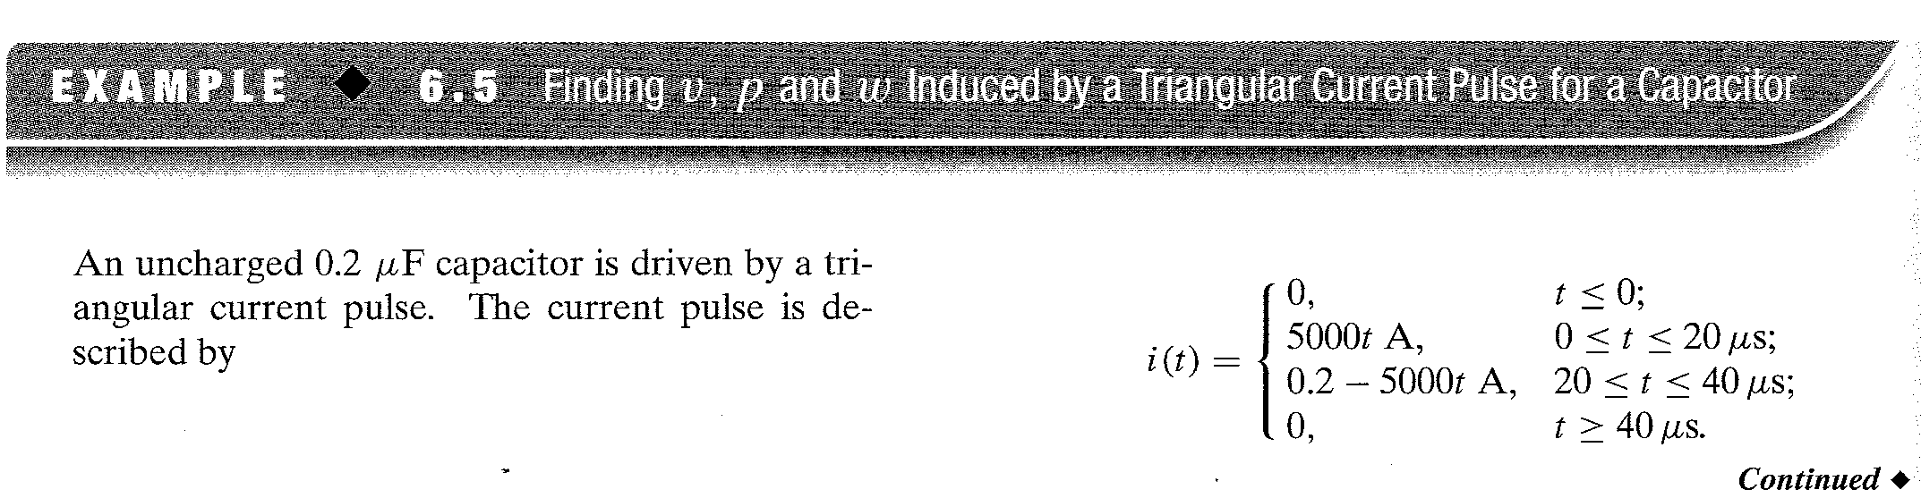
EXAMPLE 6.5

Slide 33
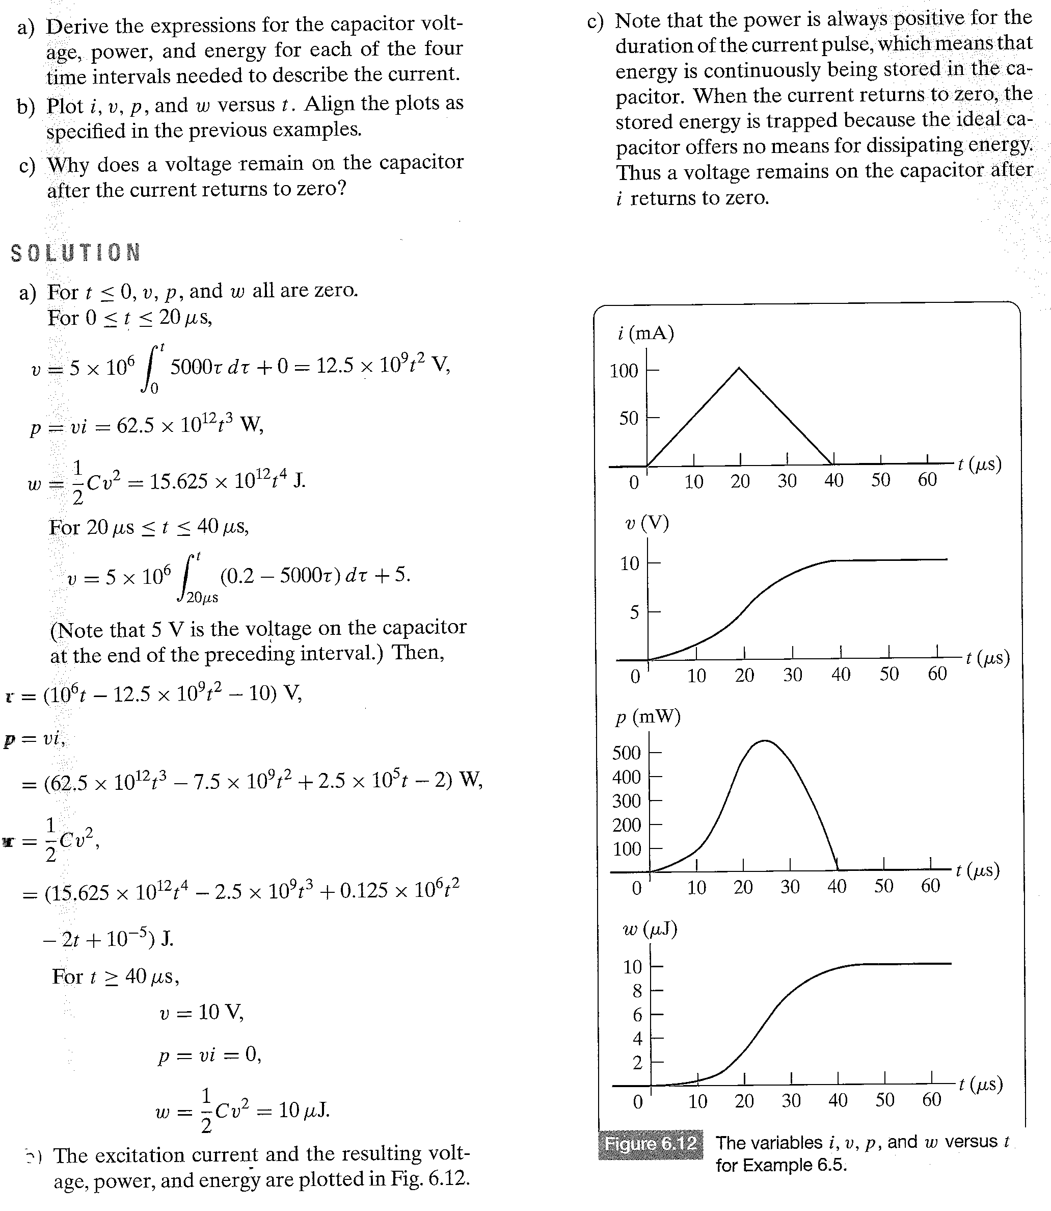
EXAMPLE 6.5

Slide 34
HW Assessing Objective 2, 6.2,6.3

Slide 35
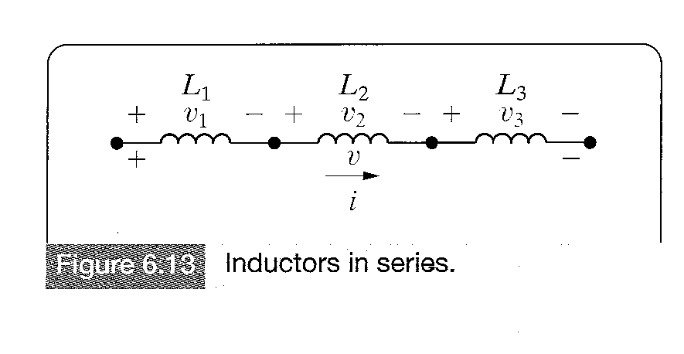
Series-Parallel Combinations of Inductance and Capacitance
Figure 6.13 Inductors in Series
Like series-parallel combinations of resistors,series-parallel combinations of inductors and capacitors can be reduced to a single inductor and capacitor.Figure 6.13 shows inductors in series.Here the inductors are forced to carry the same current,thus we define only one current for the series combination.

Slide 36
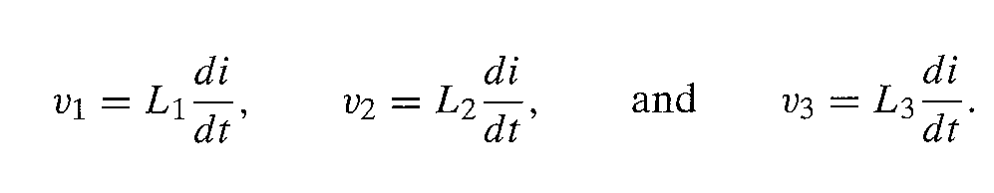
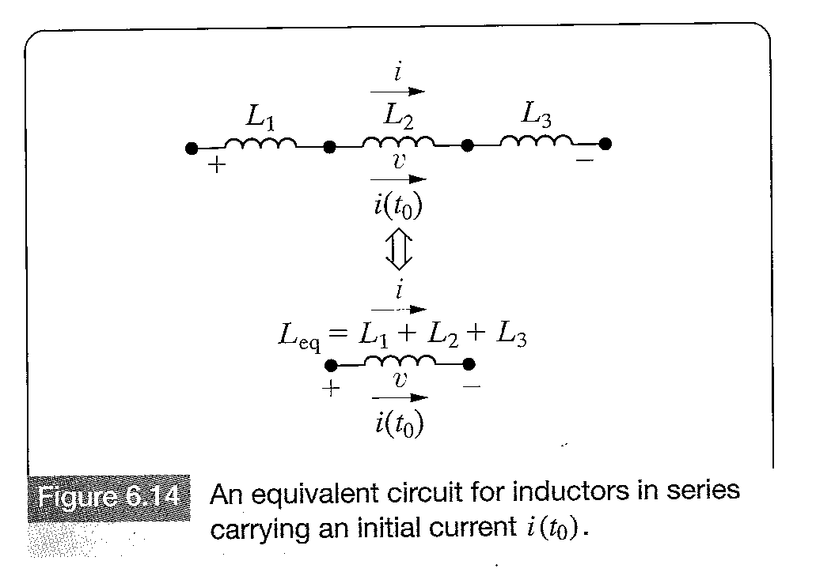
Series-Parallel Combinations of Inductance and Capacitance
The voltage drop across the individual inductors are:

Slide 37
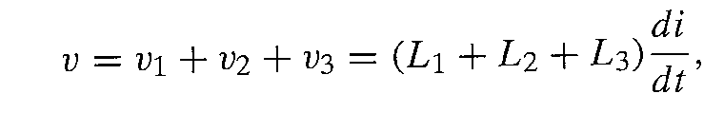
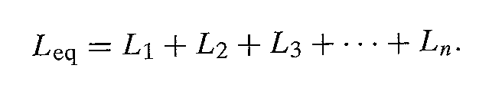
Series-Parallel Combinations of Inductance and Capacitance
The voltage across the series connection is
From this for L inductors in series
İf the original inductors carry an initial current i(t0),the equivalent inductor carries the same initial current.Figure 6.14 shows the equivalent circuit for series inductors carrying an initial current.

Slide 38
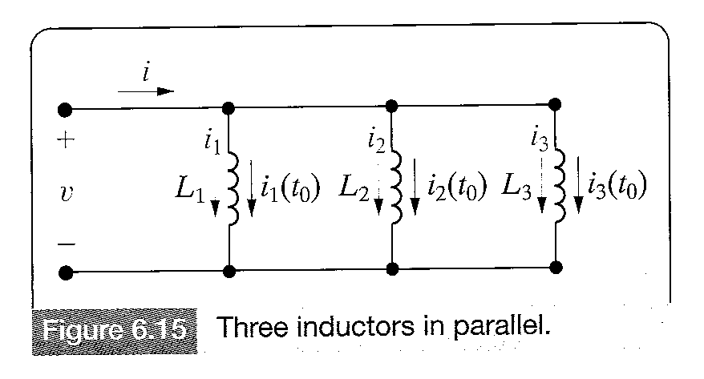
Series-Parallel Combinations of Inductance and Capacitance
Inductors in parallel have the same terminal voltage.In the equivalent circuit,the current in each inductor is a function of the terminal voltage and the initial current in the inductor.For the three inductors in parallel shown in Figure 6.15,the currents for the individual inductors are

Slide 39

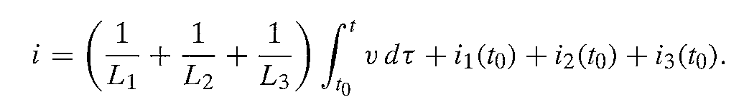
Series-Parallel Combinations of Inductance and Capacitance
The current at the terminal of the three parallel inductors is the sum of the inductor currents:
(6.21)
Substituting Equation 6.20 into Equation 6.21 yields:
(6.22)

Slide 40
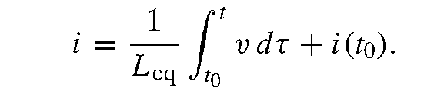
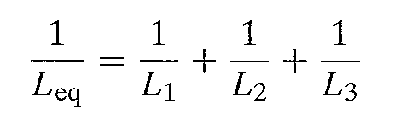
Series-Parallel Combinations of Inductance and Capacitance
Now we can interpret Equation 6.22 in terms of a single inductor,that is
6.23
Comparing Equation (6.23) with (6.22)
(6.24)

Slide 41
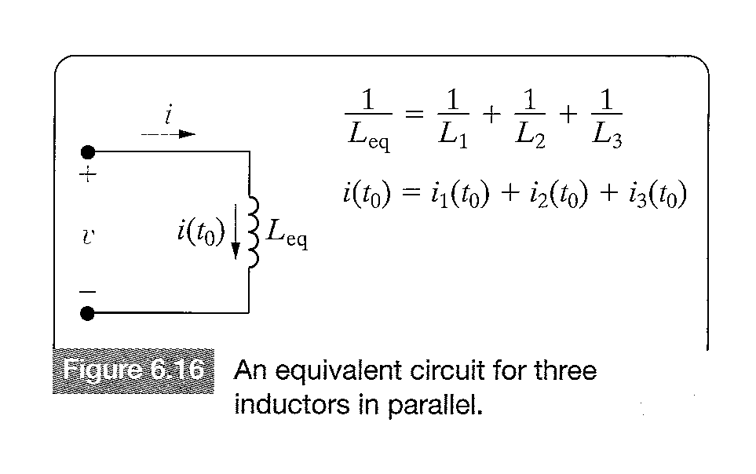
Series-Parallel Combinations of Inductance and Capacitance
Figure 6.16 shows the equivalent circuit for the three parallel inductors in Figure 6.15
Figure 6.16 An equivalent circuit for three inductors in parallel.

Slide 42
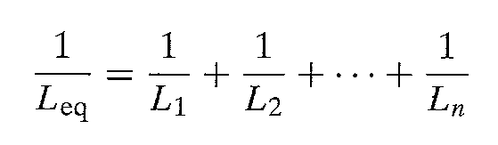
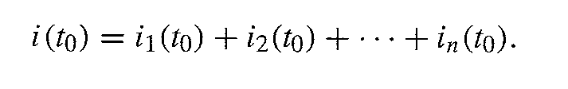
Series-Parallel Combinations of Inductance and Capacitance
The results expressed in Equations 6.24 and 6.25 can be extended to n inductors in parallel.
(6.26)
(6.27)

Slide 43
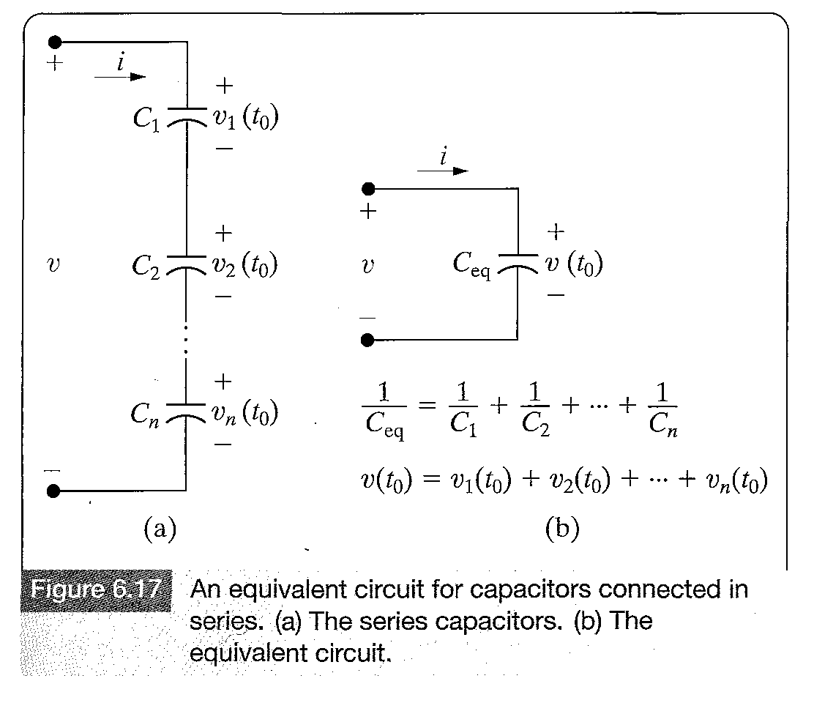
Series-Parallel Combinations of Inductance and Capacitance
Capacitors connected in series can be reduced to a single equivalent capacitor.

Slide 44
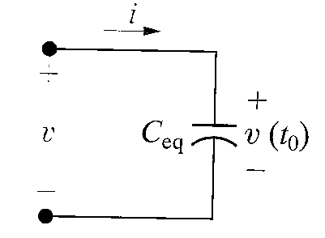
Series-Parallel Combinations of Inductance and Capacitance
The equivalent capacitance of series combination
For n capacitors connected in series
(6.28)
(6.29)

Slide 45
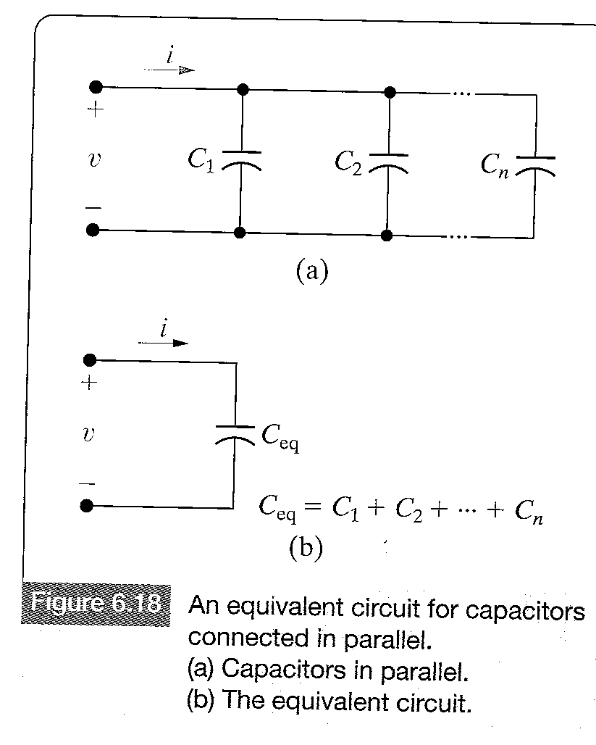
Series-Parallel Combinations of Inductance and Capacitance
The equivalent capacitance of capacitors connected in parallel.

Slide 46
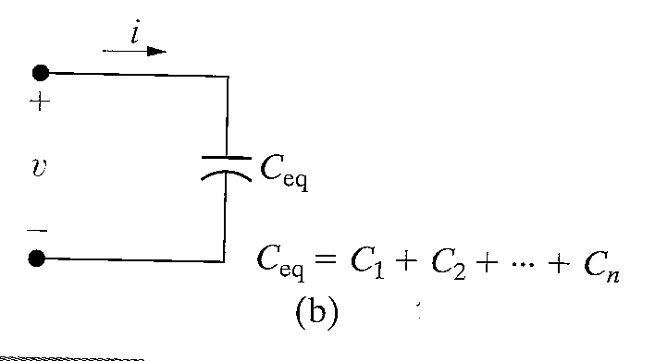
Serial-Parallel Combinations of Inductance and Capacitance
The equivalent capacitance of capacitors connected in parallel.
For n capacitors :

